Slide 1
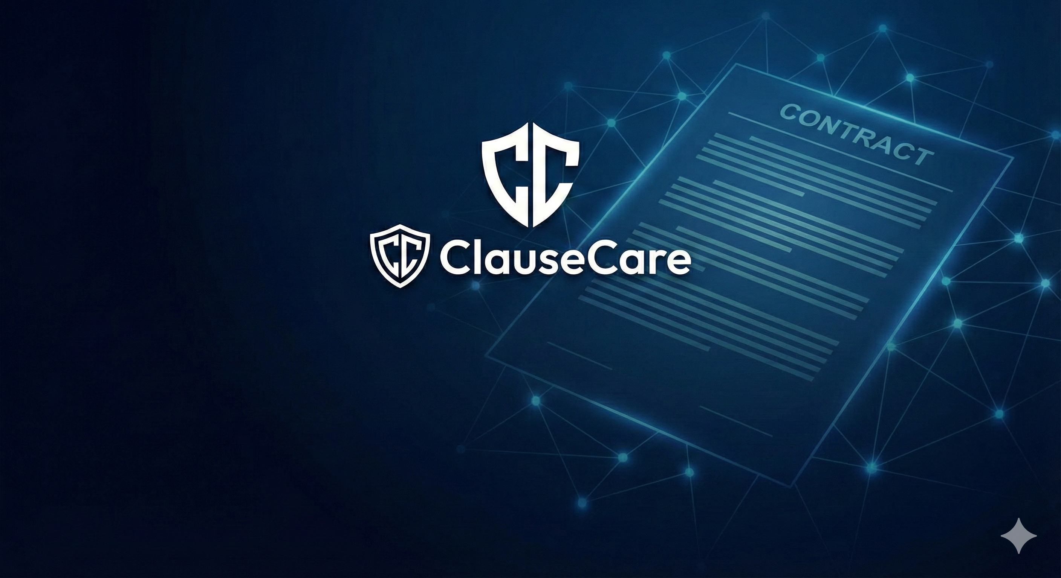
Intelligent analysis, risk detection, and negotiation strategies.
Team Name :- CodeSigma

Slide 2
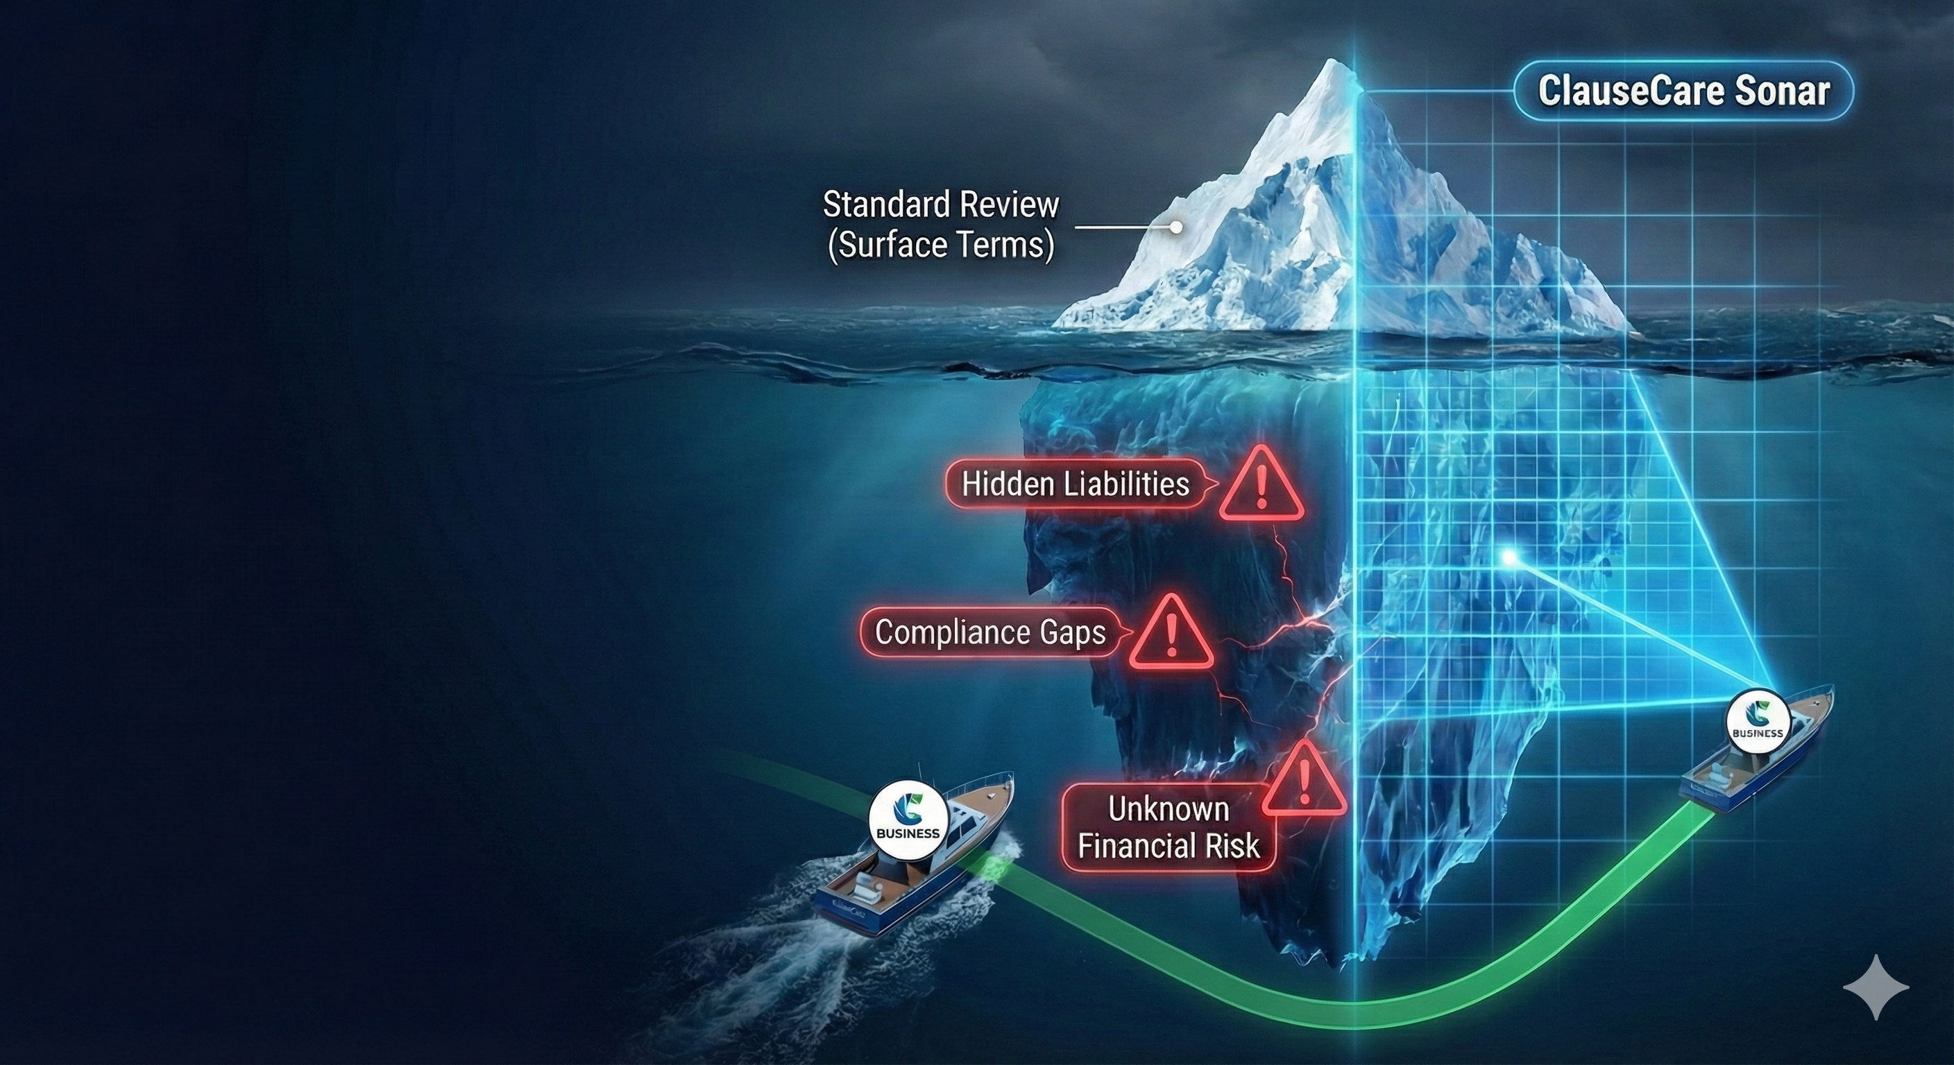
The Problem: Legal Complexity
Time-Consuming: Professionals spend hours reviewing routine documents.
Hidden Risks: Manual review often misses critical clauses, costing millions.
Language Barrier: Non-lawyers struggle with complex jargon.
The Solution: ClauseCare
Instant Analysis: Analyzes contracts in
seconds, not hours.
Plain English: Translates "Legalese" into understandable language.
Accessible: Supports 22+ Indian languages.
Proactive: Identifies risks before you sign.

Slide 3
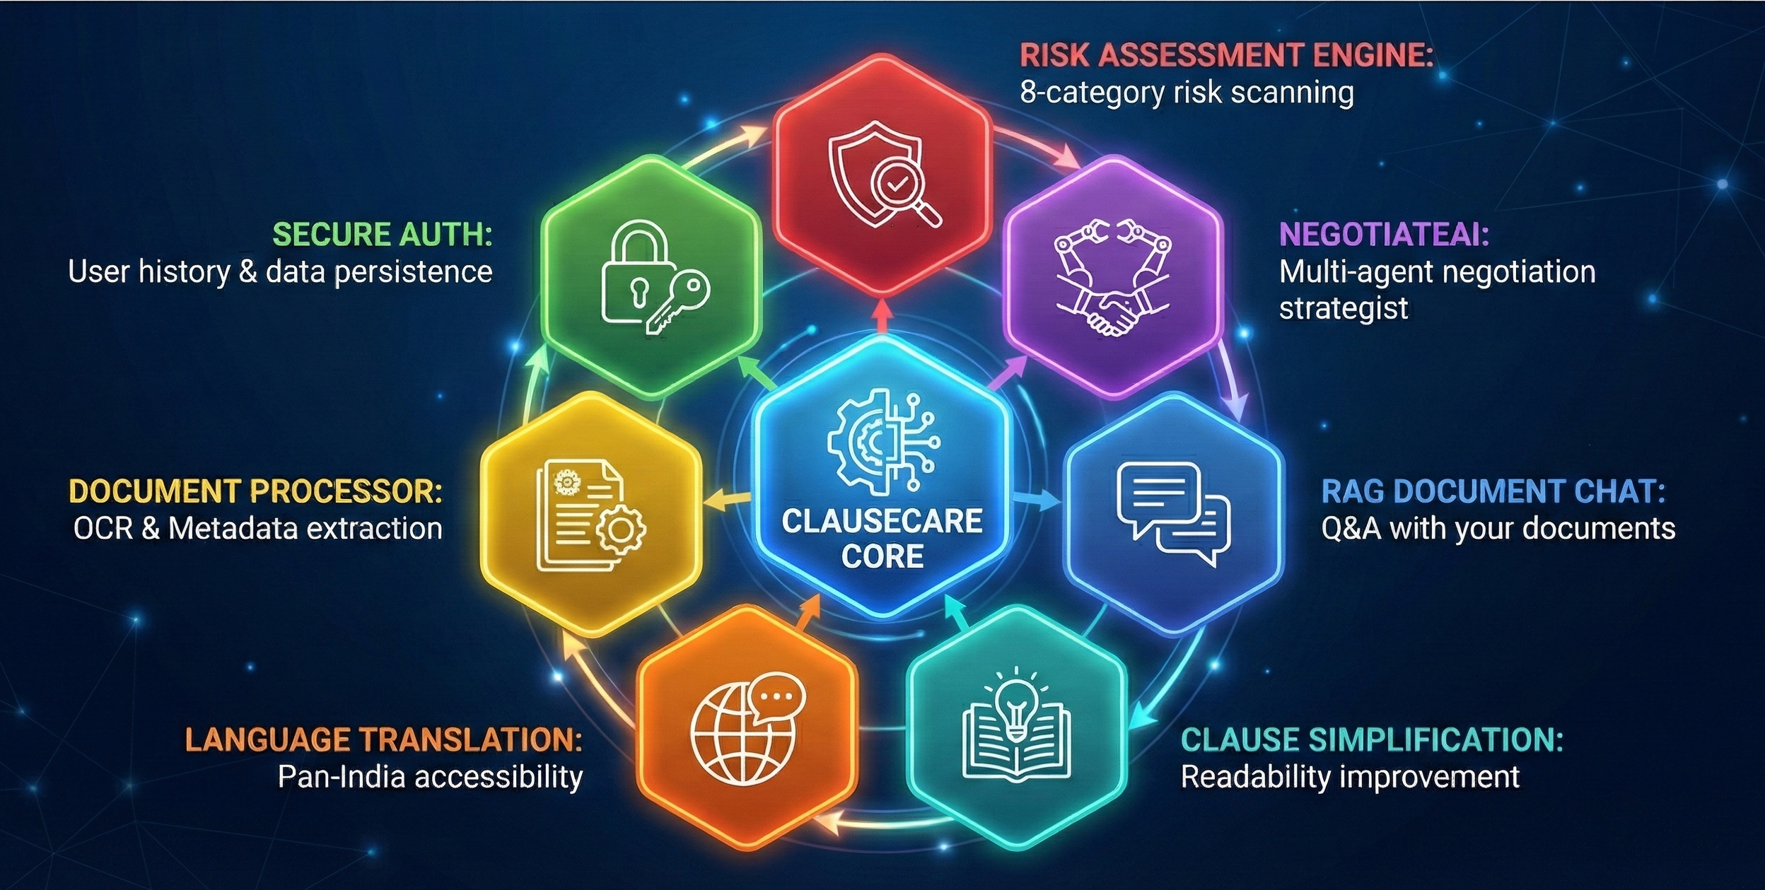
Core Features Overview
An ecosystem of 7 powerful AI modules designed for complete document lifecycle management.

Slide 4
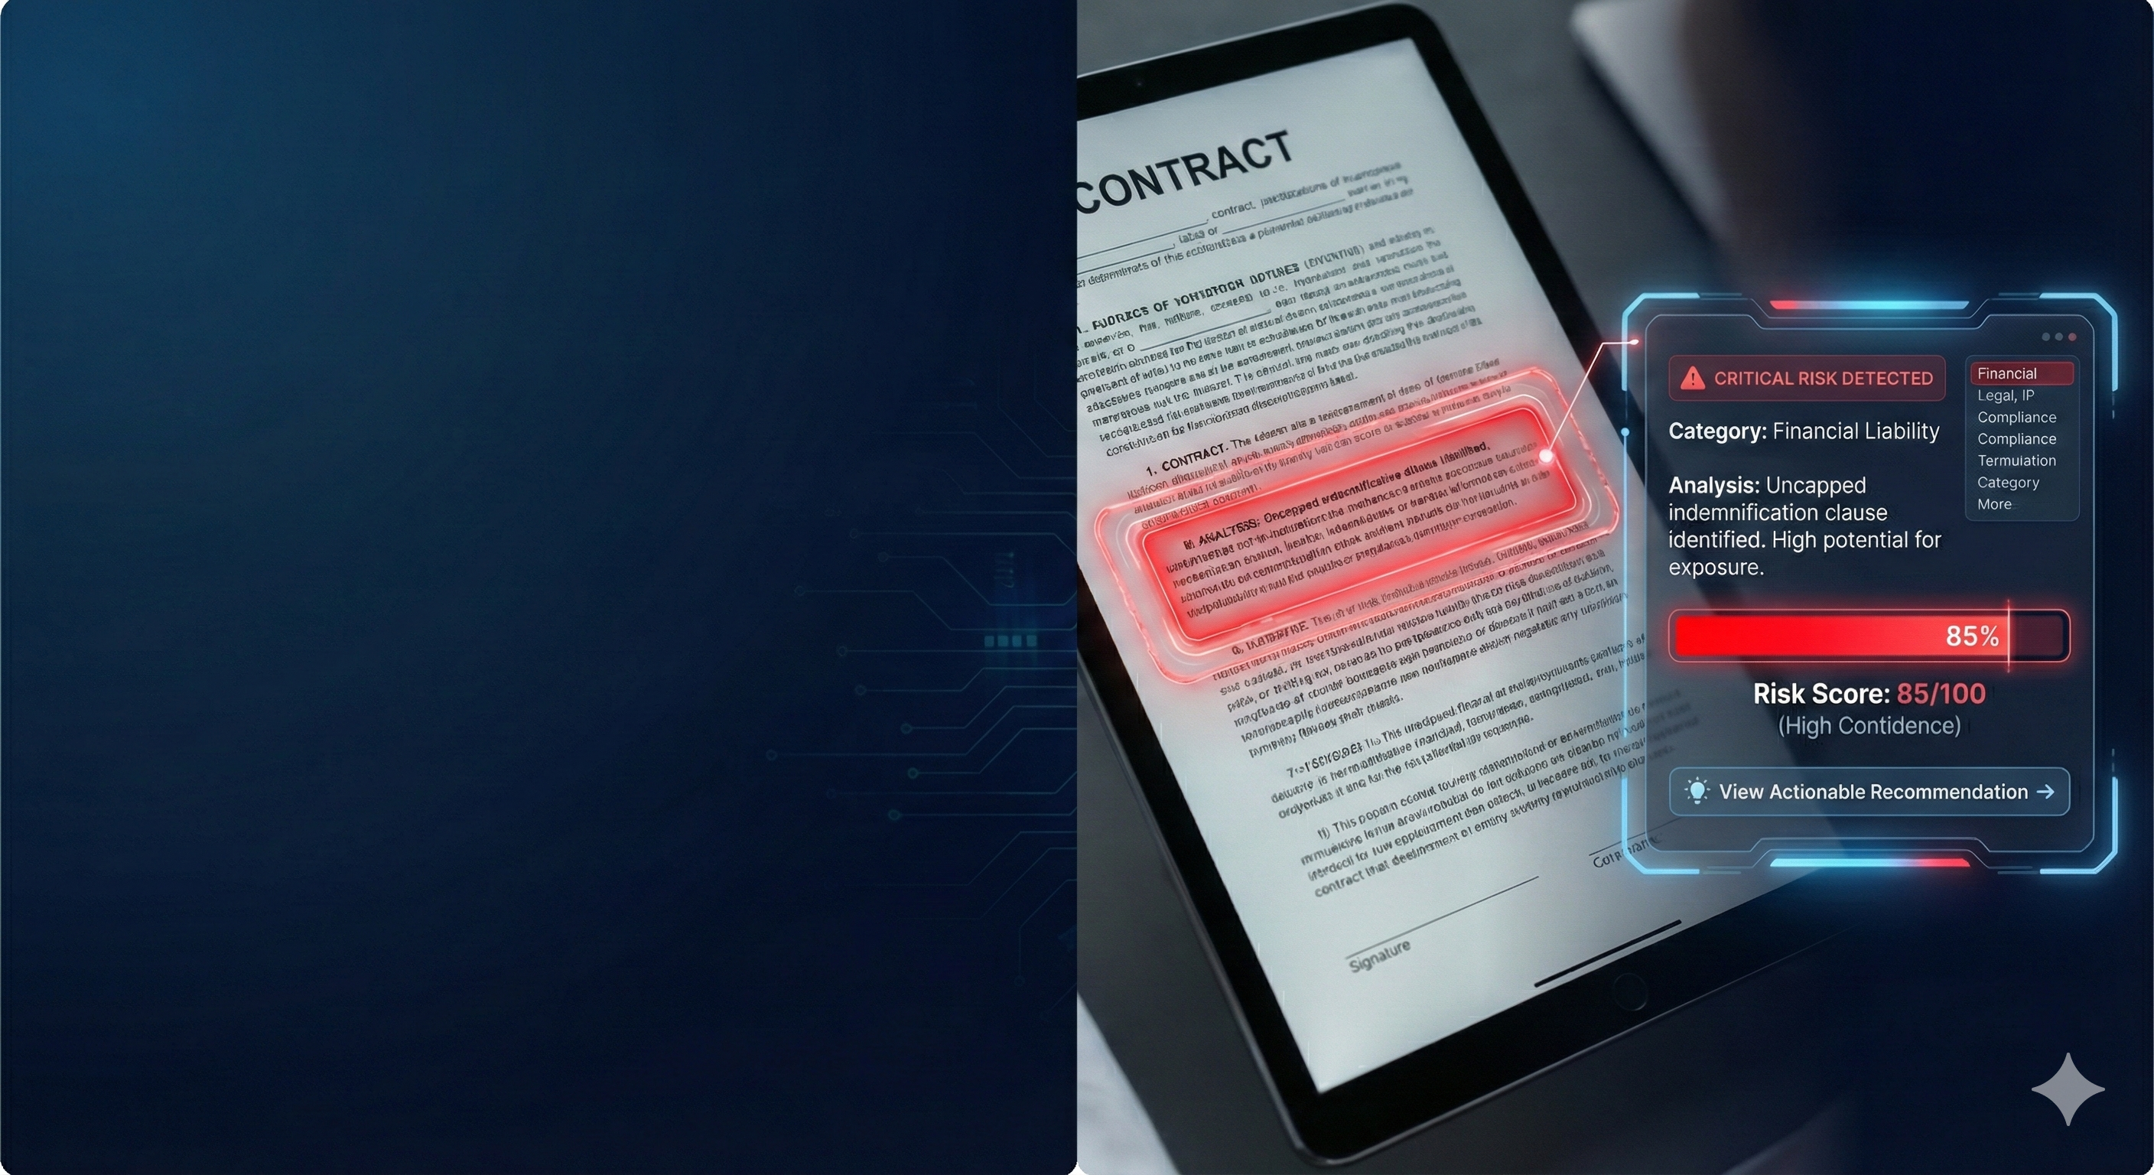
Feature Spotlight - Risk Assessment Engine
Two-Tier Analysis for Maximum Safety:
How it works: Combines fast keyword scanning with deep AI contextual analysis.
8 Risk Categories: Financial, Legal, Termination, IP, Confidentiality, Dispute, Compliance, Operational.
The Output:
0-100 Risk Scoring with confidence levels.
Visual Dashboards (Heatmaps & Gauges).
Actionable recommendations for every identified risk.

Slide 5
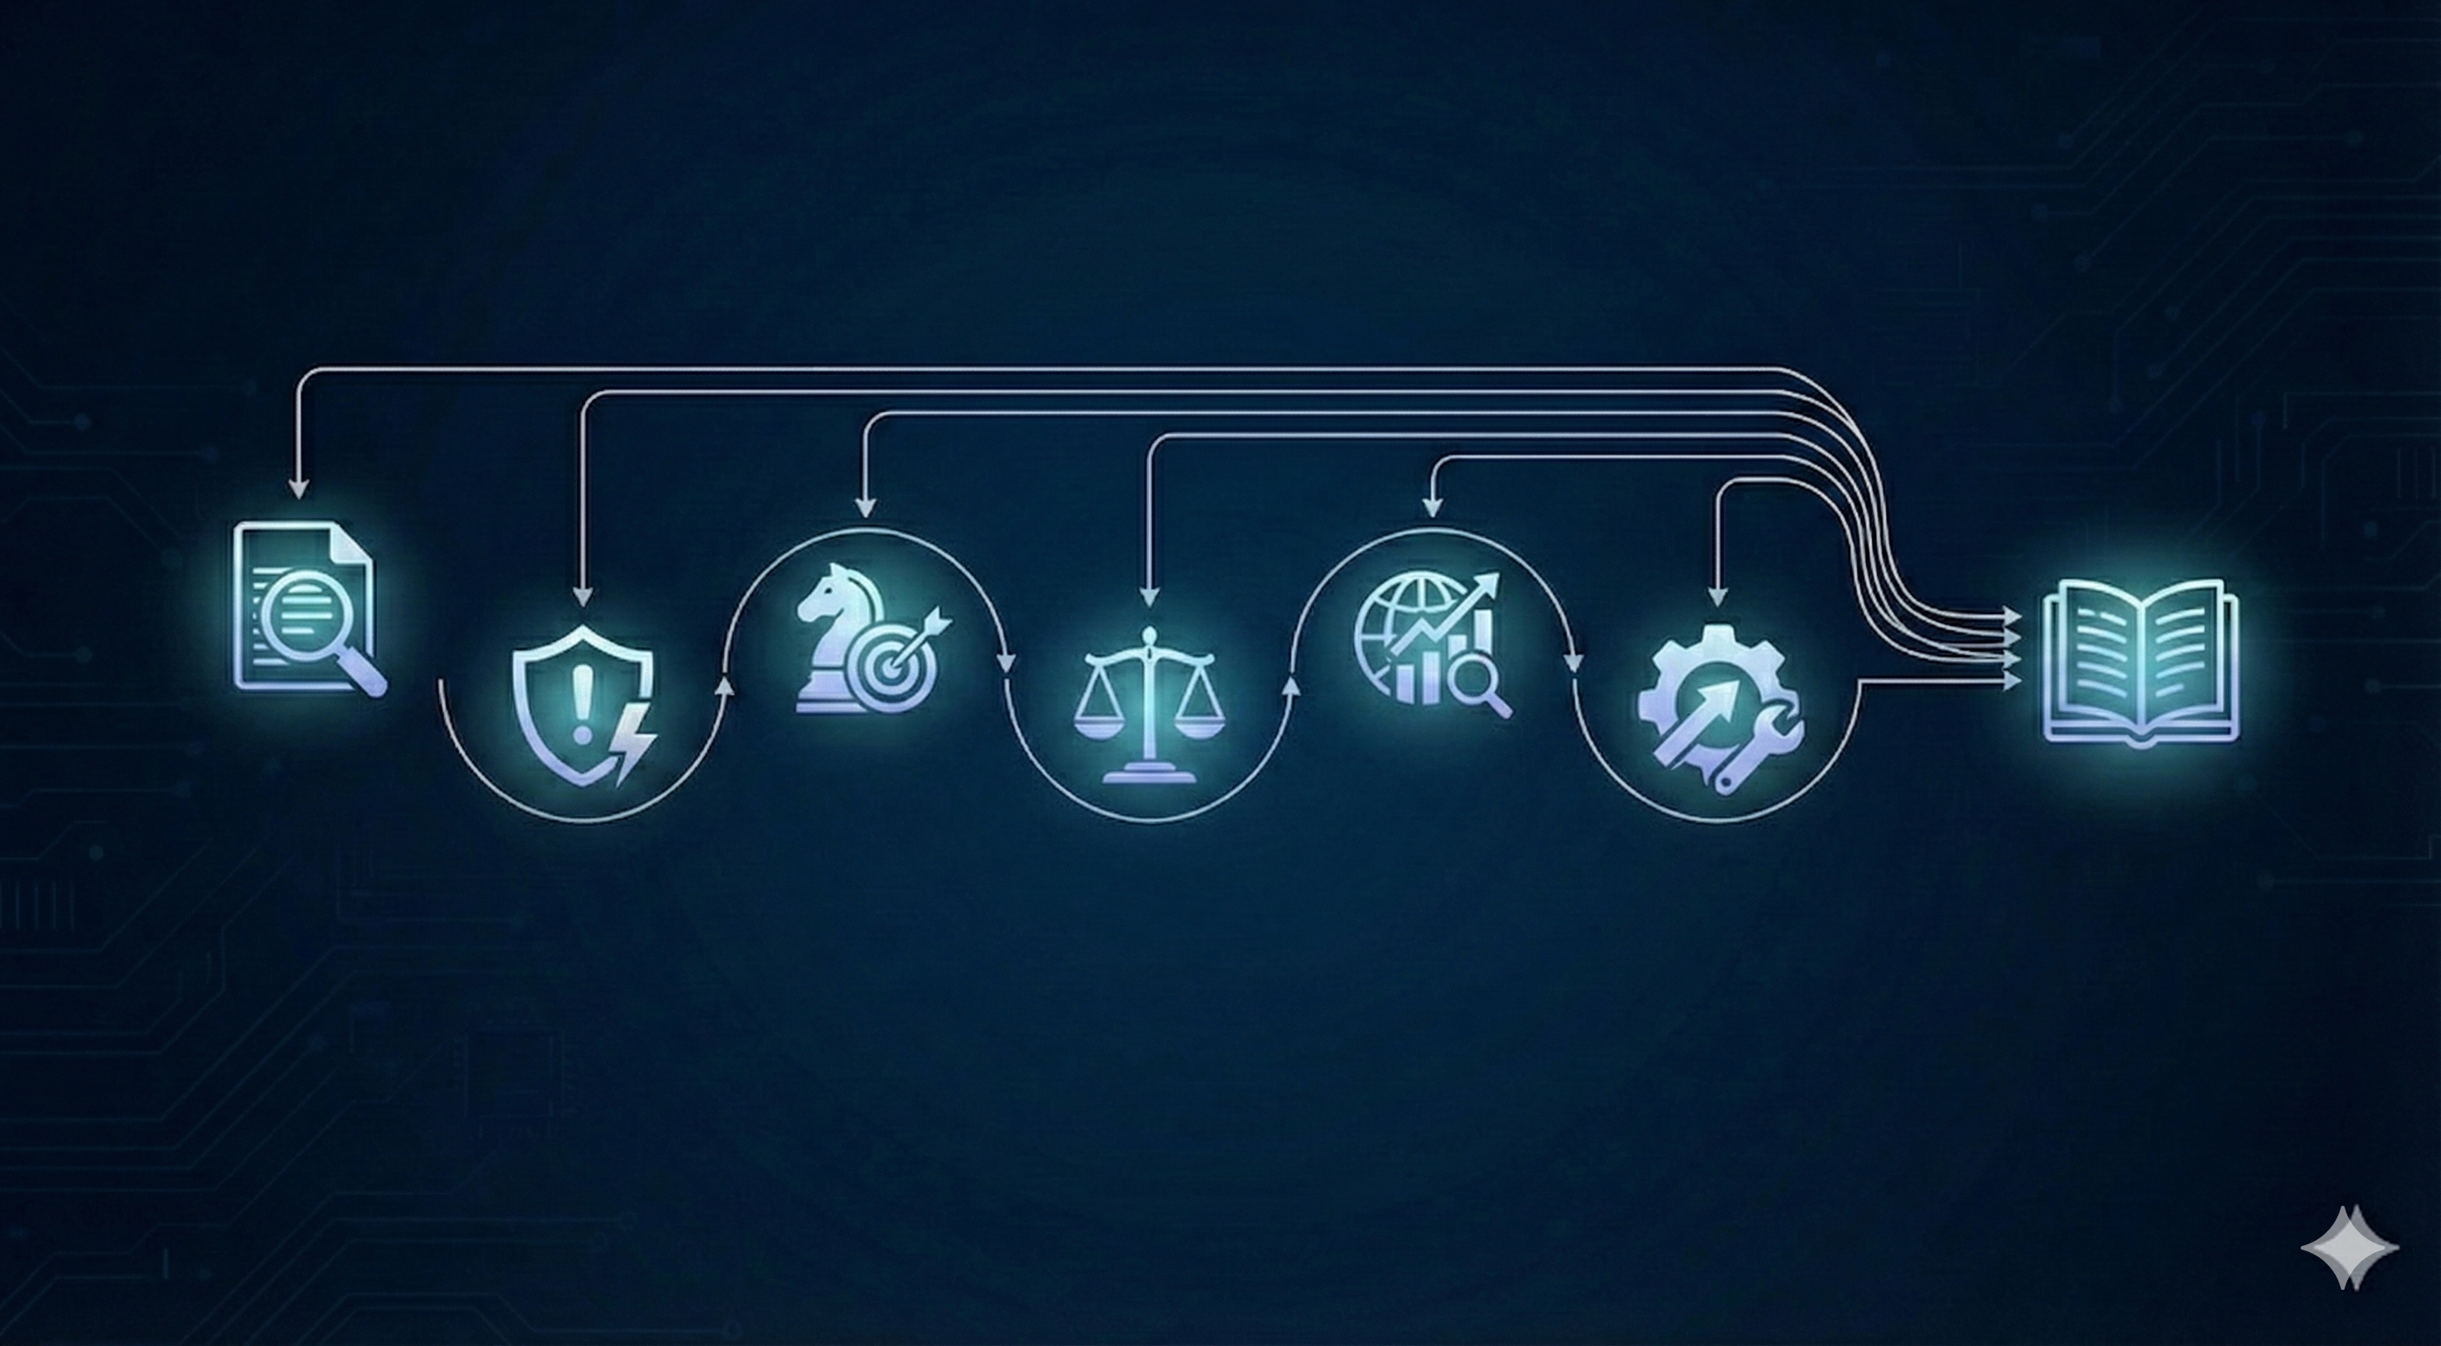
Feature Spotlight - NegotiateAI (6-Agent System)
A Revolutionary Multi-Agent System for Strategy
Analyzer: Extract Structure
Strategist:
Creates BATNA & Tactics
Market Researcher:
Benchmarks Data
Negotiation Playbook
Risk Assessor:
Prioritize Threats
Legal Advisor:
Ensures Compliance
Optimizer:
Suggests Better Training
Outcome: A complete Negotiation Playbook with specific talking points and success predictions.

Slide 6
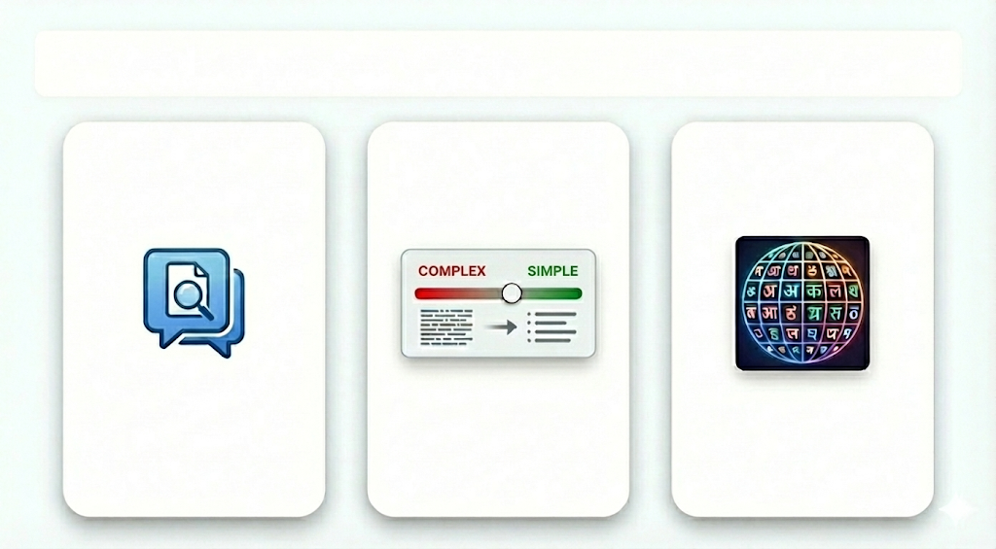
Accessibility & Inclusivity
RAG Document Chat
Clause Simplification
22+ Indian Languages
Ask questions in plain English
Powered by FAISS vector store for accurate citations.
Improves Flesch Reading Ease scores.
Provides "Before vs. After" comparisons.
Full support for Hindi, Bengali, Tamil, Telugu, Marathi, and more.
Translates entire strategies and summaries.

Slide 8
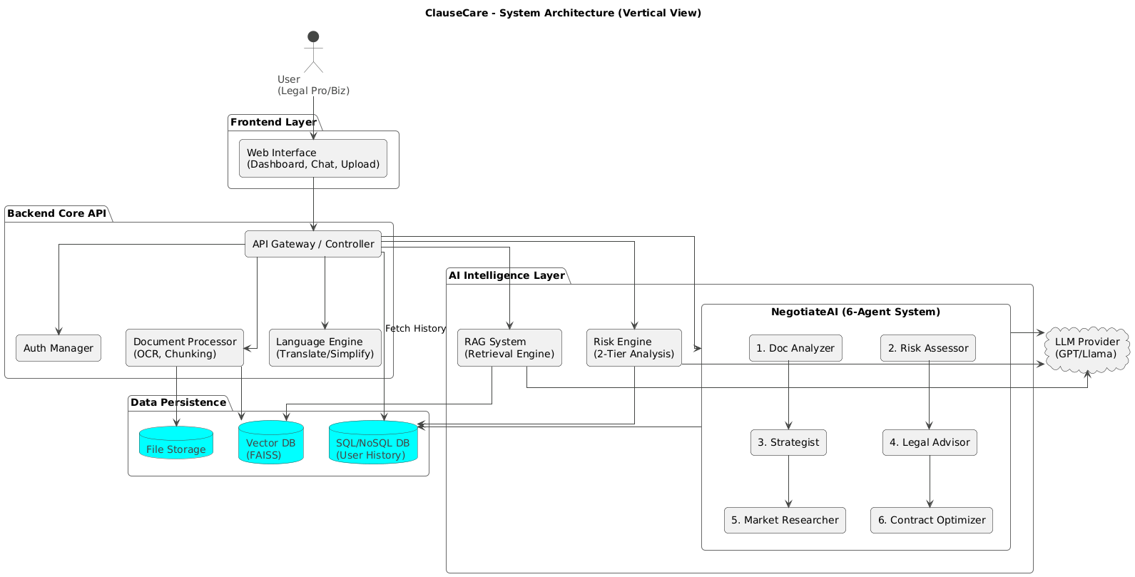
Technical Architecture & Security

